Slide 1
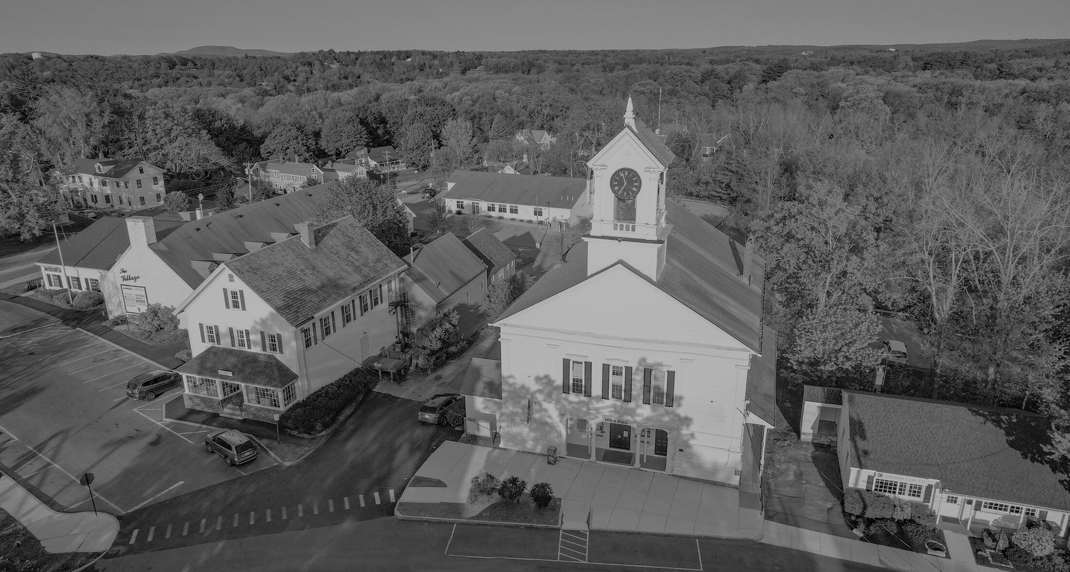

PRELIMINARY BUDGET PRESENTATION
THE TOWN OF LUNENBURG
Presented by
Jennifer Warren-Dyment
Town Manager

Slide 2
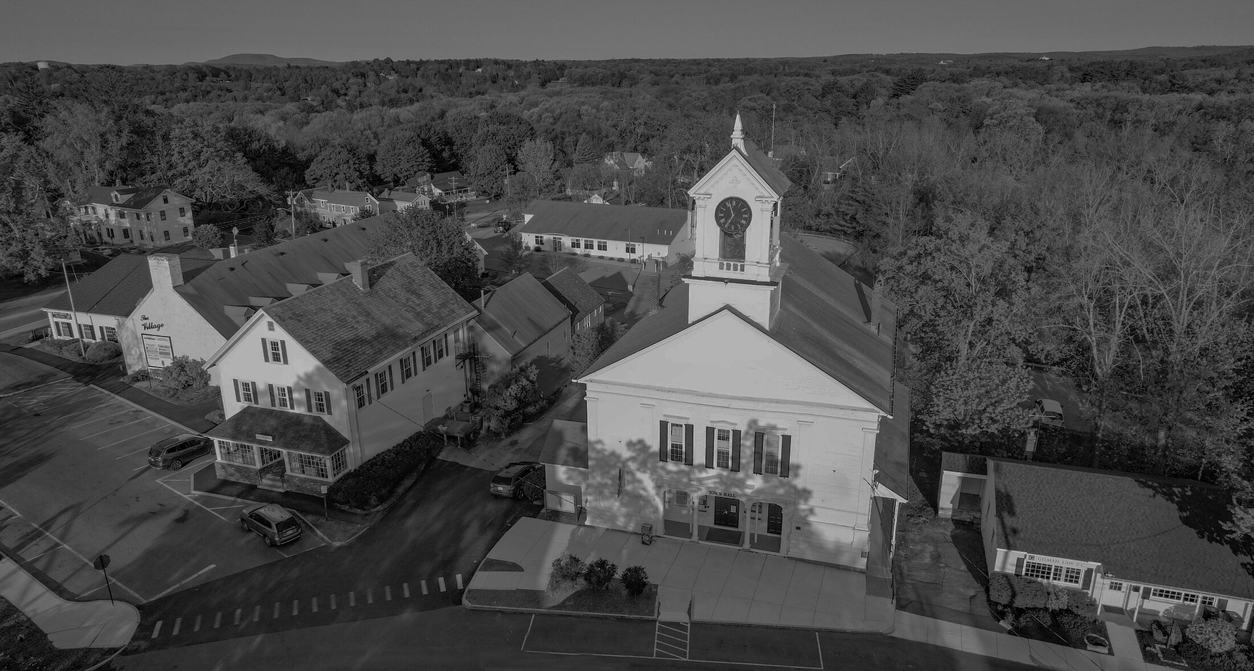
Fiscal Year 2026 Budget Timeline
July | Sept. | Oct. & Nov. | Dec. | January | Feb. | March | April | May
Capital Planning kickoff Meeting | Depts. compile capital requests | Capital requests vetted by CPC | CPC ranks capital projects Depts. develop operating budgets | Operating budget requests due to Town Manager Governor’s budget released on 1.22.25 | Town Manager presents Preliminary Budget Finance Committee begins to review budget requests with Depts. | Finance Committee continues to review budget requests with Depts. Town Manager continues to revise budget ATM Warrant closes 3.17.25 Finance Committee Public Hearing 3.13.25 | Warrant booklets mailed to residents | Annual Town Meeting 5.3.25 at 9:00 a.m. Annual Town Election 5.17.25

Slide 3
FY 2026 REVENUES

Slide 4
FY 2026 Revenues
Property Tax: $35,005,838
Net State Aid: $9,803,871
Local Receipts: $3,360,524
Other Available Funds: $423,912
Transfer from Sewer Enterprise: $301,174
Transfer from PEG: $29,197
Water Betterment: $55,087
Artificial Turf Revolving: $38,453
Total: $48,594,145

Slide 5
FY 2026 Property Tax
FY 2025 Levy Limit (less debt exclusions): $31,602,108
2 ½ % Increase: $790,052.70
Estimated New Growth: $400,000
Excluded Debt: $2,213,677
MAXIMUM ALLOWABLE LEVY: $35,005,838

Slide 6
New Growth
What is New Growth?
The additional tax revenue generated by new construction, renovations and other increases in the property tax base during a calendar year. It does not include value increases caused by normal market forces or by revaluations.

Slide 7
New Growth
FY 24 and FY25 higher actual new growth due to new construction,
and parcels missed in ‘22 and ‘23
FY 26 New Growth Estimate: $400,000

Slide 8
FY 2026 Local Receipts Estimate
Definition: Local estimated receipts include motor vehicle, meals and room excises, fines and forfeits, fees, licenses and permits, other departmental receipts, penalties and interest on taxes and excises and investment income. They are separate from real and personal property tax levy receipts and vary greatly in amount among communities.
“Local receipts should be budgeted conservatively and not at historically high levels”- MA Division of Local Services

Slide 9
FY 2026 Local Receipts Estimate
Receipt Type | FY 25 Projected | FY 24 Actual | FY 26 Projected
Motor Vehicle Excise | $1,871,640 | $2,069,581 | $1,875,000
Meal & Cannabis Excise | $100,980 | $140,933 | $125,000*
Penalties/Interest on Taxes and Excises | $140,000 | $141,252 | $140,000
PILOT | $1,648 | $1,609 | $1,600
Fees | $176,052 | $285,988 | $180,000
Dept. Revenue- Schools (Pre-School Tuition, Parking, Special Education Reimbursement) | $60,207 | $150,100 | $61,411
Dept. Revenue Cemetery Burials | $3,500 | $4,050 | $3,500
Other Departmental Revenue (Ambulance) | $257,370 | $388,281 | $275,000*
Licenses/Permits | $331,188 | $427,164 | $350,000*
Special Assessments (Trailer Parks) | $11,844 | $6,060 | $12,000
Fines and Forfeits | $12,013 | $26,808 | $12,013
Investment Income | $85,600 | $414,577 | $100,000*
Misc. Non-Recurring (Sale of Property, Net Metering Credits, Meadow Woods P&I) | $214,449 | $407,825 | $225,000*

Slide 10
FY 2026 Local Receipts
Changes of Note
Meal and Cannabis Excise Tax: Increased by $24,020
Other Departmental Revenue (Ambulance): Increased by $17,630
Licenses/Permits: Increased by $18,812
Investment Income: Increased by $14,400
Misc. Non-Recurring: Increased by $10,551

Slide 11
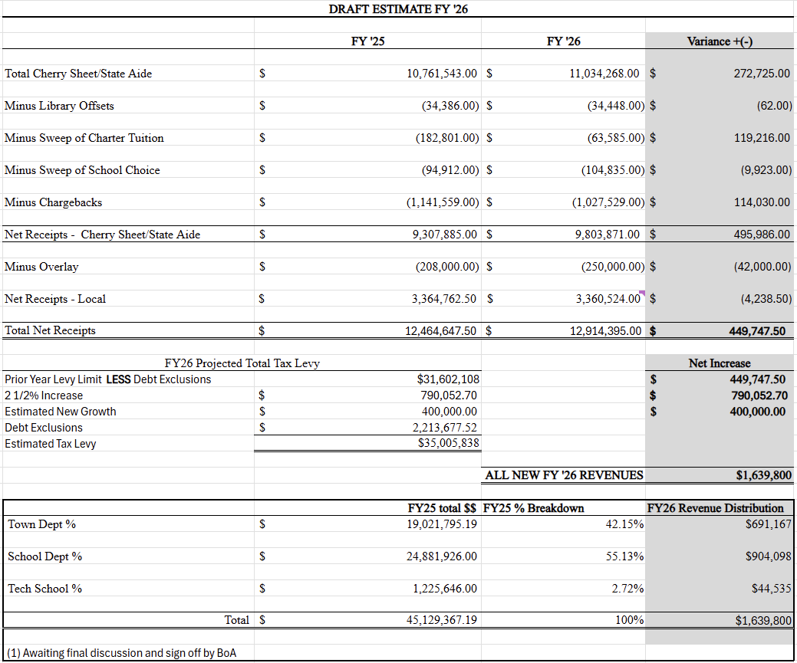
FY 2026 Additional Available Revenue

Slide 12
FY 2026 FREE CASH EXPENDITURE PLAN

Slide 13
FY 2026 Prelim. State Aid
State Aid Receipts- $11,034,268
Chapter 70: $9,109,185
Charter Tuition Reimbursements: $63,585*
Smart Growth School Reimbursement: $199,015
School Choice Receiving Tuition: $104,835*
UGGA: $1,330,763
Veterans Benefits: $51,599
Exemptions: $92,232
State Owned Land: $48,606
Library: $34,448**
* Sweeps to School budget
** Sweeps to Library budget
Cherry Sheet Assessments- $1,027,529
Mosquito Control: $89,897
Air Pollution Districts: $3,968
RMV Non-Renewal Surcharge: $13,920
MBTA: $12,394
Regional Transit: $77,917
School Choice Sending Tuition: $361,043
Charter School Sending Tuition: $468,390
Net State Aid: $9,803,871

Slide 14
Free Cash
Free cash is the remaining, unrestricted funds of operations of the Town’s previous fiscal year net after certain revenue deficits (e.g. unpaid property taxes) Free cash is a nonrecurring source of revenue.
It includes:
Unexpended Free Cash from the previous year
Actual receipts in excess of revenue estimates
Unspent amounts in budget line-items.
Because Free Cash is non-recurring revenue, it should not be used to fund any personnel, program, or initiative that would require expenditures in subsequent fiscal years.

Slide 15
Free Cash
The Financial Management Resource Bureau (FMRB) recommends that communities understand the role free cash plays in sustaining a strong credit rating and encourages them to adopt policies on its use.
Under sound financial policies, a community strives to generate free cash in an amount equal to 5% to 7% of its annual budget.
This goal helps deter free cash from being depleted in any particular year, which enables the following year's calculation to begin with a positive balance. To do this, the community would orchestrate conservative revenue projections and departmental appropriations to produce excess income and departmental turn backs.

Slide 16
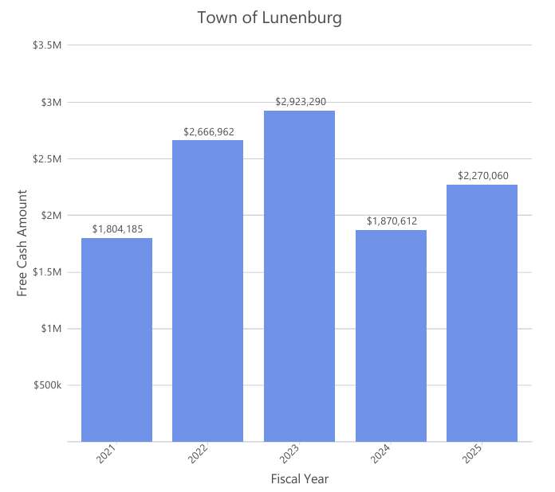
Lunenburg Free Cash History
Under sound financial policies, a community strives to generate free cash in an amount equal to 5% to 7% of its annual budget.
4.24%
6.23%
6.52%
3.93%
4.56%

Slide 17
Free Cash Policy-
Select Board Policy 3.03
Priority | Goal | FY26 Applied to Goals | Planned Transfer
1 | Increase the balance of the Stabilization Account (if necessary) to a level of at least 5% percent of the current FY omnibus budget. | Current FY omnibus budget: $45,129,367 5%: $2,256,468 Stabilization Balance: $3,037,534 | $100,000
2 | Transfer 10% of previous FY Free Cash to the OPEB Trust Fund | Free Cash: $2,225,000 10%: $222,500 | $222,500
3 | Transfer into Special Purpose Stabilization Fund | No specific criteria | $250,000

Slide 18
Stabilization Funds
Stabilization Funds are one or more special reserve accounts allowed by MGL c. 40 §§ 5A, 5B, 5C to provide for extraordinary or unforeseen expenditures (a/k/a “Rainy Day Funds”)
The Government Finance Officers Association (GFOA) that a community maintains an overall reserve balance of between 5 and 15% of the overall budget.

Slide 19
General Stabilization Funds
6.3% of proposed
FY 26 budget
GFOA recommends between 5 and 15%
Plan to transfer $100,000 in Free Cash into the General Purpose Stabilization Fund

Slide 20
Special Purpose Stabilization Funds
Vehicle/Equipment: $2,553,972
Health Insurance: $10,642
Zoning Incentive: $246,627
Reserve Capacity: $9,263
Sewer Inflow & Infiltration: $5,486
Plan to transfer $250,000 in Free Cash into Special Purpose Stabilization Fund(s)

Slide 22
Other Post Employment Benefits
OPEB
Other Post-Employment Benefits that an employee will receive at the start of retirement.
This does not include pension benefits paid to the retired employee but does include medical, dental, vision, life insurance, disability insurance and any other OPEB benefits, whether optional or mandatory, in effect now or to be in effect in the future, at the time of retirement.
Total OPEB liability as of June 30, 2024: $52,294,353 (2.69% funded)
Free Cash policy calls for a transfer of
$222,500 to the OPEB Trust Fund

Slide 23
Other Planned Uses of Free Cash
Special Projects Warrant Article: $152,500
Decommissioning Portion of TC Passios: $75,000
Board of Assessors Department of Revenue Directive: $27,500
Cemetery Road Network Repair and Crack Seal: $50,000
Fiscal Year 2025 Transfers: $501,250
Snow and Ice Deficit: $415,000
School- SPEC Move In: $50,000
CAREs Grant: $36,250
FY 2026 Capital Program: $615,588
FY 2027 “Starting Free Cash”: $383,162

Slide 24
FY 2026 PRELIMINARY
EXPENDITURES

Slide 25
FY 2026 Expenditure Summary
Category | FY24 Budget | FY24 Actual | FY25 Budget Revised (Includes STM & Transfers) | FY 26 Town Manager Prelim. Recommendation
Maturing Debt | $3,518,012.81 | $3,518,012.81 | $2,941,321.50 | $2,547,440.36
General Government Unclassified | $4,144,368.33 | $3,283,351.14 | $4,293,122.97 | $4,646,870.10
General Government | $2,029,547.88 | $1,929,643.82 | $2,550,827.14 | $2,529,486.74
Central Purchasing | $80,300.00 | $86,814.07 | $86,463.82 | $84,500.00
Police | $2,347,144.21 | $2,230,663.51 | $2,443,733.09 | $2,456,249.51
Fire | $1,642,259.90 | $1,533,457.69 | $1,685,438.76 | $1,724,599.37
Radio Watch | $312,993.24 | $309,405.57 | $305,313.71 | $310,763.90
Other Protection | $288,829.03 | $192,182.40 | $56,425.00 | $56,425.00
Health & Sanitation | $108,705.15 | $107,162.27 | $117,818.75 | $126,996.30
DPW | $2,175,540.24 | $2,184,057.84 | $2,235,172.85 | $1,777,638.01

Slide 26
FY 2026 Expenditure Summary
Category | FY24 Budget | FY24 Actual | FY25 Budget Revised (Includes STM & Transfers) | FY 26 Town Manager Prelim. Recommendation
Facilities and Buildings | $983,851.71 | $988,878.27 | $1,006,695.00 | $1,040,396.30
Solid Waste/Recycling | $352,775.00 | $340,406.00 | $469,775.00 | $470,000.00
COA | $229,647.85 | $220,550.47 | $241,081.74 | $252,267.42
Veterans | $110,775.00 | $63,783.03 | $110,775.00 | $90,699.00
Schools (Lunenburg & Monty Tech) | $25,082,518 | $23,893,379.79 | $26,312,832.00 | $27,121,995.00
Library | $555,780.60 | $536,761.53 | $591,860.36 | $650,518.04
Tax Title | $29,000.00 | $13,537.67 | $29,000.00 | $30,500.00
Worcester Regional Retirement | $1,917,969.00 | $1,917,969.00 | $2,127,801.00 | $2,392,572.00

Slide 27
Maturing Debt
FY 2026 Town Manager Proposed Budget: $2,547,440.36
$393,881.14 Decrease
13.39% Decrease
Debt service is decreasing as borrowing is paid down.
$284,412.00 of the savings is being utilized to fund the FY26 capital program.
The remainder of the savings ($109,469) is being utilized to offset other areas of the operating budget. This is not a budgeting “best practice”.

Slide 28
General Government Unclassified
FY 2026 Town Manager Proposed Budget: $4,646,870.10
$353,564.13 Increase
8.24% Increase
Items of Note:
  Health Insurance increase of 14.84%
  Medicare estimated increase of $24,823 (6.62%)
  Salary reserve increased by $120,000
  No change of significance in Liability Insurance as Town Manager Lemieux negotiated a rate guarantee
  Unemployment level funded. May need to be increased if positions are eliminated.

Slide 29
General Government
FY 2026 Town Manager Proposed Budget: $2,529,486.74
$21,340.40 Decrease
.84% Decrease
Items of Note:
  $50,000 Grant Manager position has not been utilized in FY25. Discussion to be had on changing the role to Grant and Contract Manager
  Succession Planning required in Town Accountant’s Office
  IT- Increased hours for staff support, Network Administrator position remains unfunded, Telephone charges moved from Central Purchasing
  Elections decreased (Presidential election)
  Building, Planning Building, ConCom, ZBA consolidated under Land Use Department

Slide 30
Central Purchasing
FY 2026 Town Manager Proposed Budget: $84,500
$1,963.82 Decrease
2.27% Decrease
Items of Note:
  All Town postage moved from individual budgets to Central Purchasing
  Hardware maintenance moved from Central Purchasing to IT budget

Slide 31
Police
FY 2026 Town Manager Proposed Budget: $2,456,249.51
$12,516.42 Increase
.51% Increase
Items of Note:
  Contract negotiations for FY26-FY28 are beginning
  Recruitment ongoing for Police Chief
  K9 Care increased by $20,049.84 (105%)

Slide 32
Fire
FY 2026 Town Manager Proposed Budget: $1,724,599.37
$39,160.61 Increase
2.32% Increase
Items of Note:
  Does not incorporate 4th shift/42 hour week proposal

Slide 33
Radio Watch
FY 2026 Town Manager Proposed Budget: $310,763.90
$5,450.19 Increase
1.79% Increase
Item of Note:
  Regional Dispatch decreases if Hudson joins

Slide 34
Other Protection
FY 2026 Town Manager Proposed Budget: $56,425.00
$95,388.80 Decrease
62.83% Decrease
Items of Note:
  Building Commissioner moved from Other Protection to Land Use under General Government (no actual savings)

Slide 35
Health and Sanitation
FY 2026 Town Manager Proposed Budget: $126,996.30
$9,177.56 Increase
7.79% Increase

Slide 36
DPW
FY 2026 Town Manager Proposed Budget: $1,777,638.01
$457,534.84 Decrease
20.47% Decrease
Items of Note:
  New Union representation for employees
  Contract has not been negotiated for FY25 or FY26
  $550,000.00 pavement management line reduced to zero to balance budget. Will rely on Chapter 90 funding (FY25 amount: $418,227.26)
  Drainage increased by $15,000 (25%)
  Snow contracted services increased by $110,500
  Park purchase of services increased by $10,000

Slide 37
Facilities and Buildings
FY 2026 Town Manager Proposed Budget: $1,040,396.30
$33,701.30 Increase
3.35% Increase
Items of Note:
  $14,903 increase in utility and maintenance lines for public buildings
  Purchase of service line increased by $27,000 to cover reduction in revenue from School Department moving from TC Passios
  $10,000 increase in landscaping contract

Slide 38
Solid Waste & Recycling
FY 2026 Town Manager Proposed Budget: $470,000.00
$225.00 Increase
.05% Increase

Slide 39
Council on Aging
FY 2026 Town Manager Proposed Budget: $252,267.42
$11,185.68 Increase
4.64% Increase
Items of Note:
  Increased staff to 36 hour per week position

Slide 40
Veterans
FY 2026 Town Manager Proposed Budget: $90,699
$20,076.00 Decrease
18.12% Decrease
Items of Note:
  Reduction does not affect benefits received by Lunenburg veterans.

Slide 41
Schools
FY 2026 Town Manager Proposed Budget: $27,121,995.00
$809,163 Increase
3.08% Increase
$25,787,474 to Lunenburg Public Schools
$1,334,51 to Monty Tech

Slide 42
Library
FY 2026 Town Manager Proposed Budget: $650,518.04
$58,657.68 Increase
9.91% Increase
Items of Note:
  Additional staff hours

Slide 43
Tax Title
FY 2026 Town Manager Proposed Budget: $30,500
$1,500.00 Increase
5.17% Increase

Slide 44
Worcester Regional Retirement
FY 2026 Town Manager Proposed Budget: $2,392,572
$264,771 Increase
12.44% Increase
Non-Discretionary

Slide 45
What’s Next?
We will continue to revise budgets over the next several weeks.
Finance Committee Public Hearing 3.13.25
Annual Town Meeting 5.3.25 at 9:00 a.m.
State Budget finalized by early summer

Slide 46
THANK YOU

