Slide 1
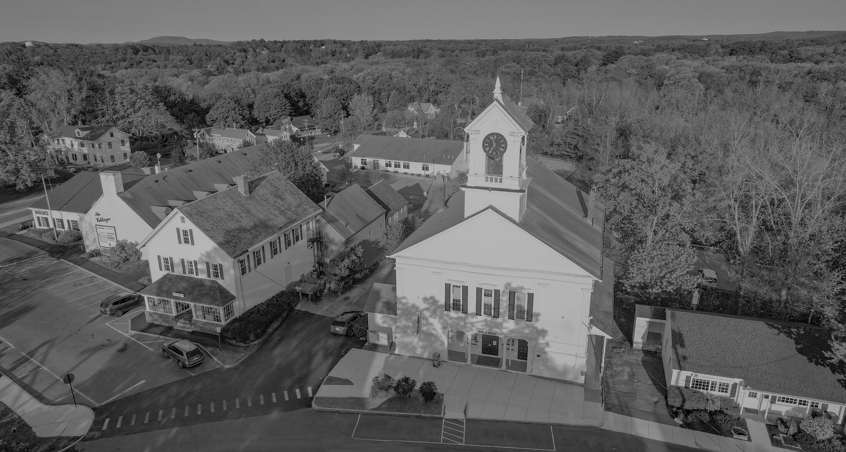

PRELIMINARY FY26 CAPITAL PROGRAM
THE TOWN OF LUNENBURG
Presented by
Jennifer Warren-Dyment
Town Manager

Slide 2
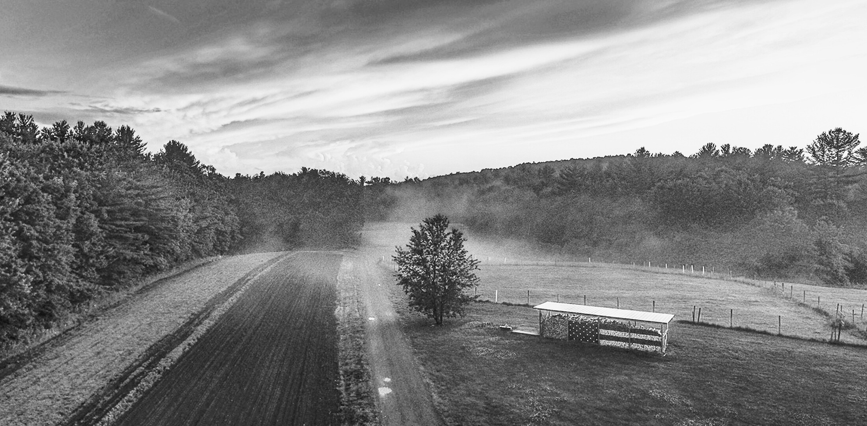
Preliminary
FY26 Capital Program
Dept. | Project Name | Cost | Cumulative Cost
Police | Patrol Cruiser | $72,058 | $72,058
Schools | Primary School Feasibility Study for Entry & Drive Way Expansion | $30,000 | $102,058
Fire | Fire Prevention / Duty Officer Vehicle | $75,000 | $177,058
Facilities | Library HVAC Upgrades | $32,000 | $209,058
Facilities | Town Hall HVAC Upgrades | $113,000 | $322,058
Schools | Primary School Designer Services, Playground Equipment | $30,000 | $352,058
Schools | THES Hot Water Tank | $20,000 | $372,058
Facilities | Senior Center, Flooring | $41,000 | $413,058
Facilities | Teen Center, Replace Floors | $35,000 | $448,058
Facilities | Public Safety Building 2nd Floor Design – Office Space & File Storage | $42,000 | $490,058
Police | Patrol Cruiser | $72,058 | $562,116
Facilities | Town Hall, Window Replacement | $210,000 | $772,116
DPW | Compact Backhoe | $115,000 | $887,116
Schools | Replacement of Security Camera Central Server | $40,000 | $927,116
Facilities | Senior Center Parking Design | $32,000 | $959,116
DPW | 1 Ton Truck - Utility Body / Plow | $70,000 | $1,029,116
Schools | Primary School Window Safety Film | $26,865 | $1,055,981
DPW | North Cemetery Expansion Area Prep | $50,000 | $1,105,981
Facilities | Marshall Pond Weed Treatment | $50,000 | $1,155,981
 | Contingency | $69,019 | $1,225,000
 |  | $1,225,000

Slide 3
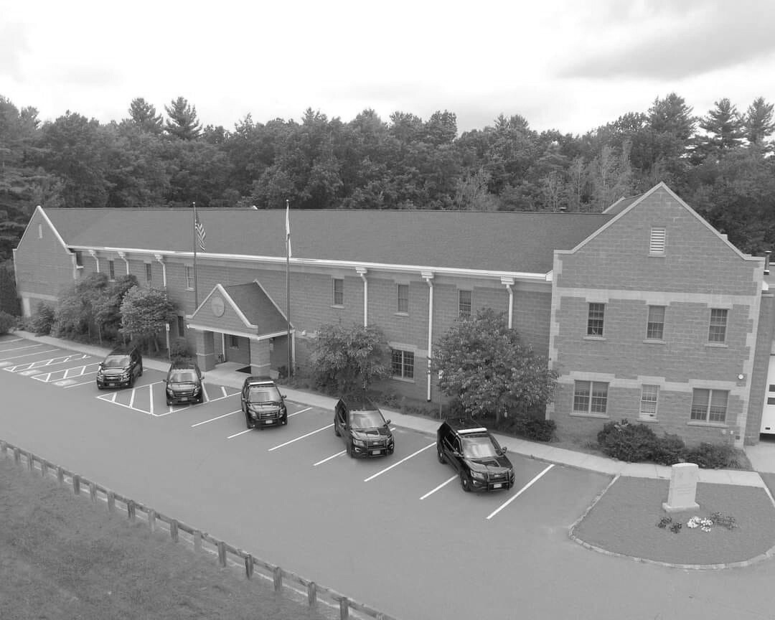
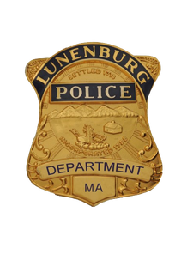
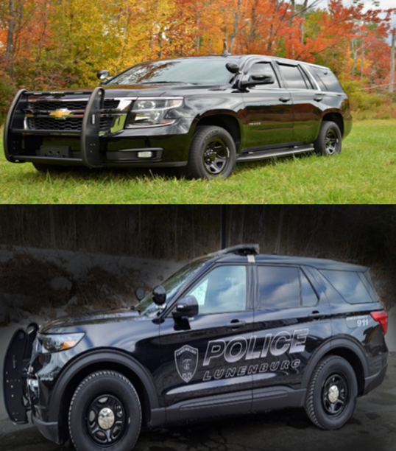
Preliminary
FY26 Capital Program
Patrol Cruisers (2): $72,058 each
  Replacing two 2020 Ford Explorer Hybrids (mileage @ 100,195 and 81,420) with 2026 Ford Explorer hybrids

Slide 4
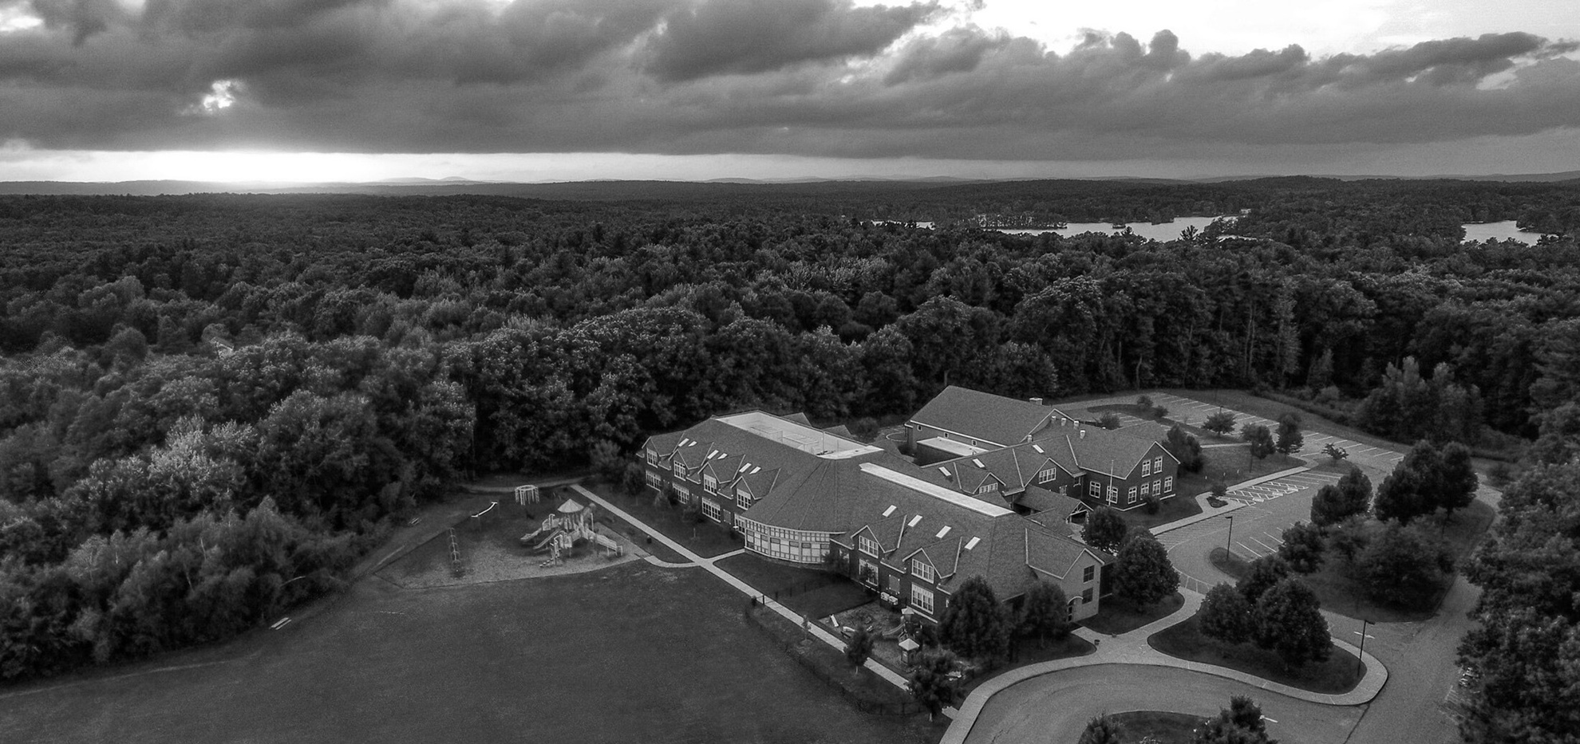
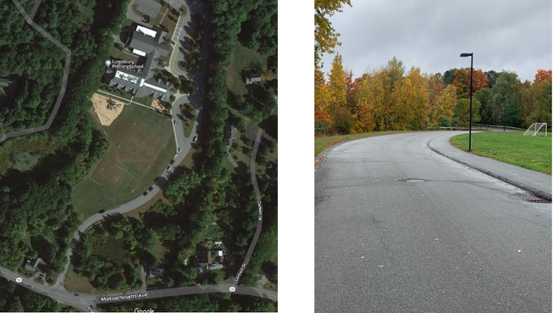
Preliminary
FY26 Capital Program
Primary School Feasibility Study for Entry & Drive Way Expansion: $30,000
  Mass Ave. entry expansion options
  Parking Capacity
  Emergency Access

Slide 5
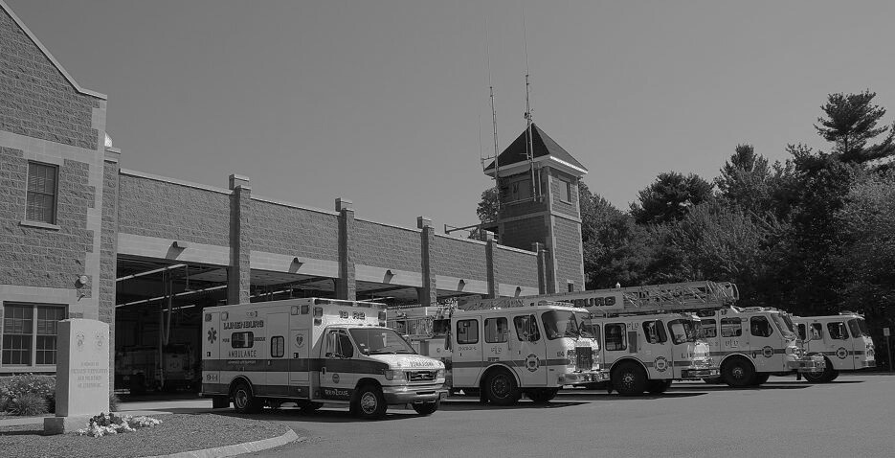
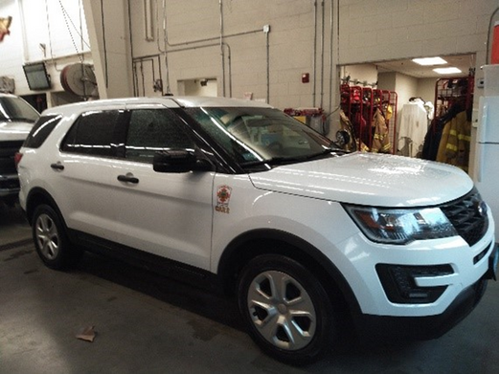
Preliminary
FY26 Capital Program
Fire Prevention / Duty Officer Vehicle: $75,000
  At 10 year planned replacement with over 100,000 miles.
  Replacing with a Ford F150 police package truck with cap and rear command console

Slide 6
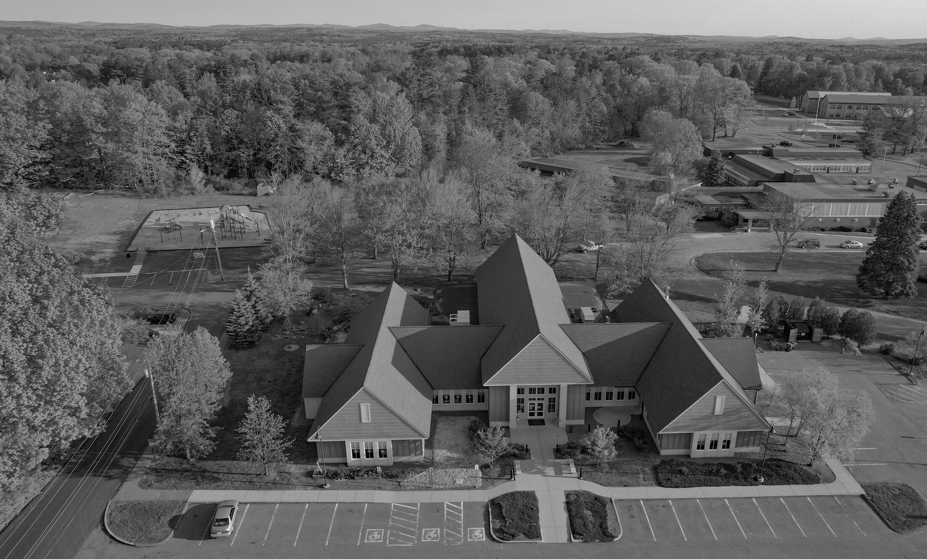
Preliminary
FY26 Capital Program
Library HVAC Upgrades: $32,000
  Design / engineering to replace the rooftop HVAC units and the automated control system
  Current system is 20 years old and maintenance is becoming costly

Slide 7
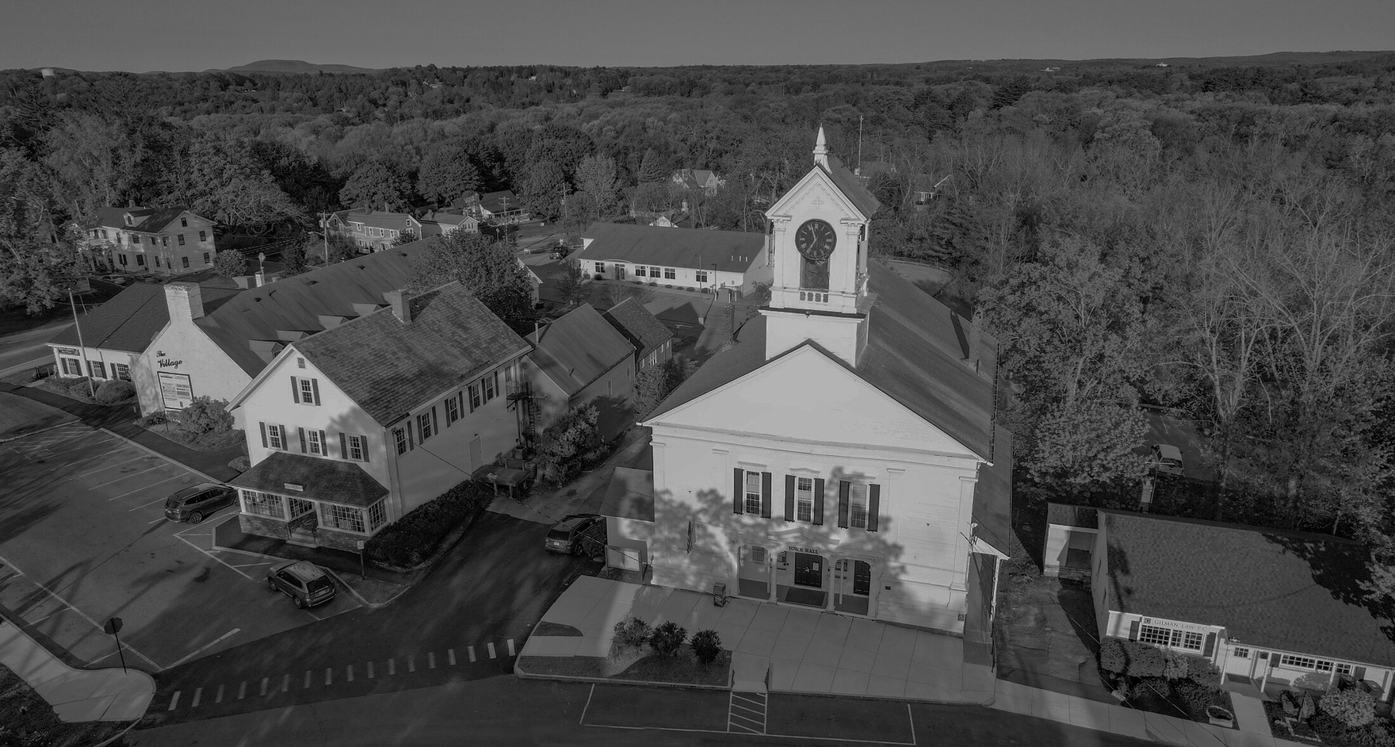
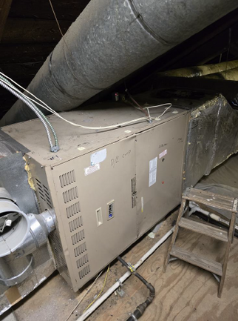
Preliminary
FY26 Capital Program
Town Hall HVAC Upgrades: $113,000
  The 2 furnaces serving the 2nd fl. of Town Hall have reached the end of their expected lifespan. The 4 air conditioning coils that serve the entire building are coming due on the end of their lifespan and need to be replaced.
This project will include the design & engineering specifications needed as well as the construction costs.

Slide 8
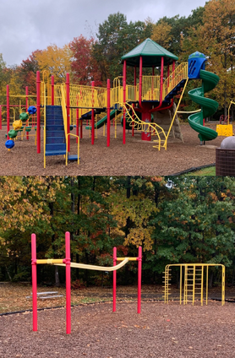
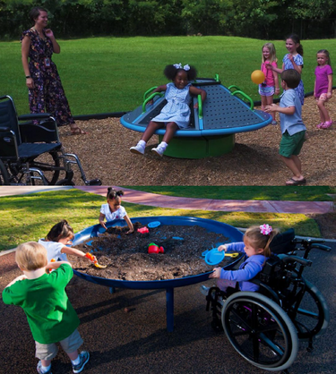
Preliminary
FY26 Capital Program
Primary School Designer Services, Playground Equipment: $30,000
  Contract with a designer to work with stakeholders in developing a new age-appropriate, inclusive and accessible playground for the Lunenburg Primary School

Slide 9
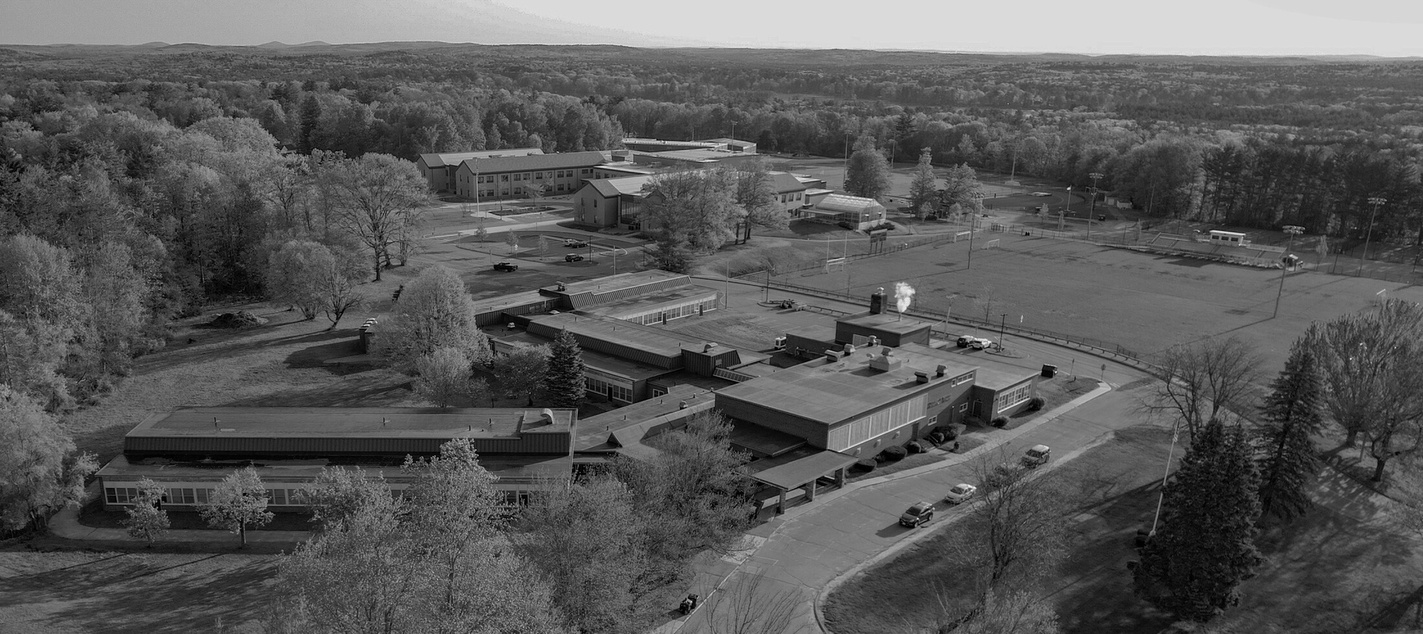
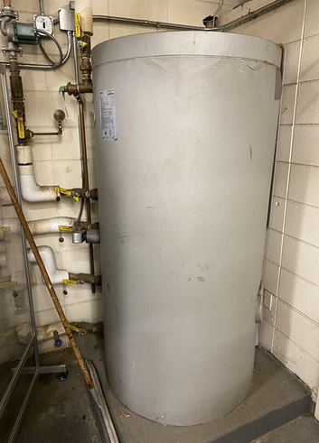
Preliminary
FY26 Capital Program
Turkey Hill Elementary School Hot Water Tank: $20,000
  Replacement of the existing Viessmann Vitocell-V 300 hot water tank
(built 2002- useful life is 20 years)

Slide 10
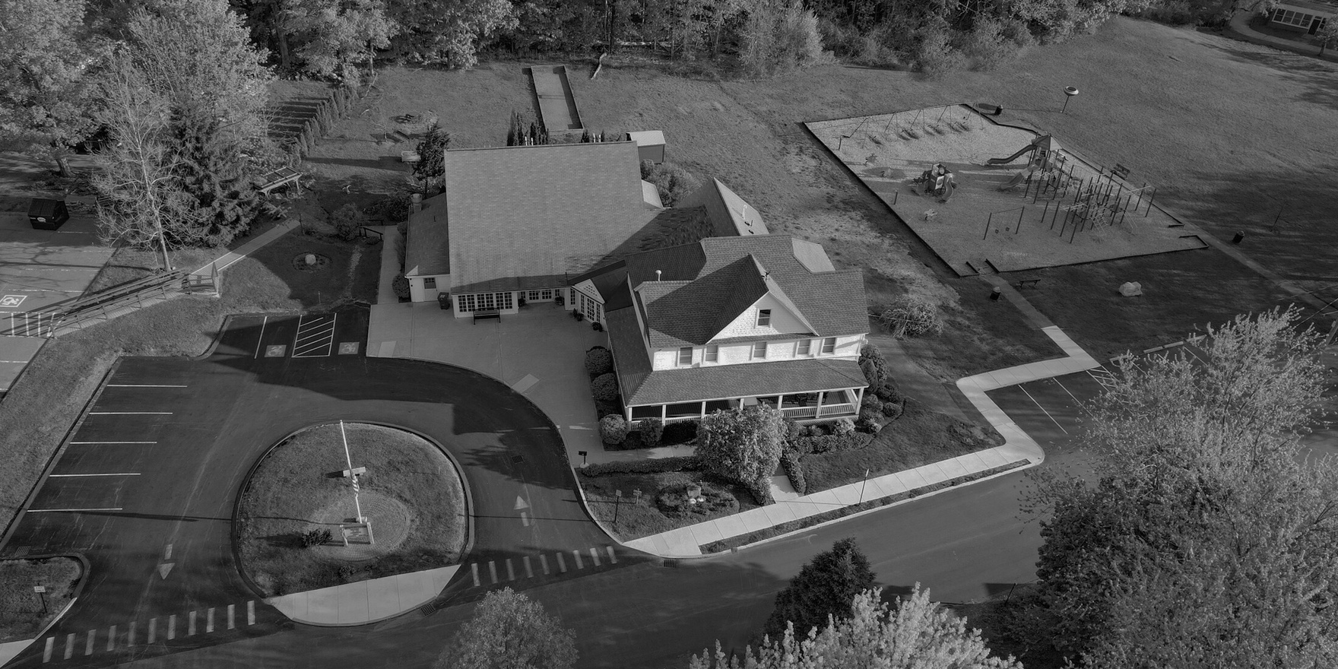
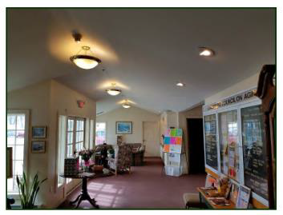
Preliminary
FY26 Capital Program
Senior Center, Flooring: $41,000
  Replace all flooring on the first level of the senior center with the exception of ceramic tile areas. The current flooring was installed at various times throughout the years and are in different states, but all could use replacement.

Slide 11
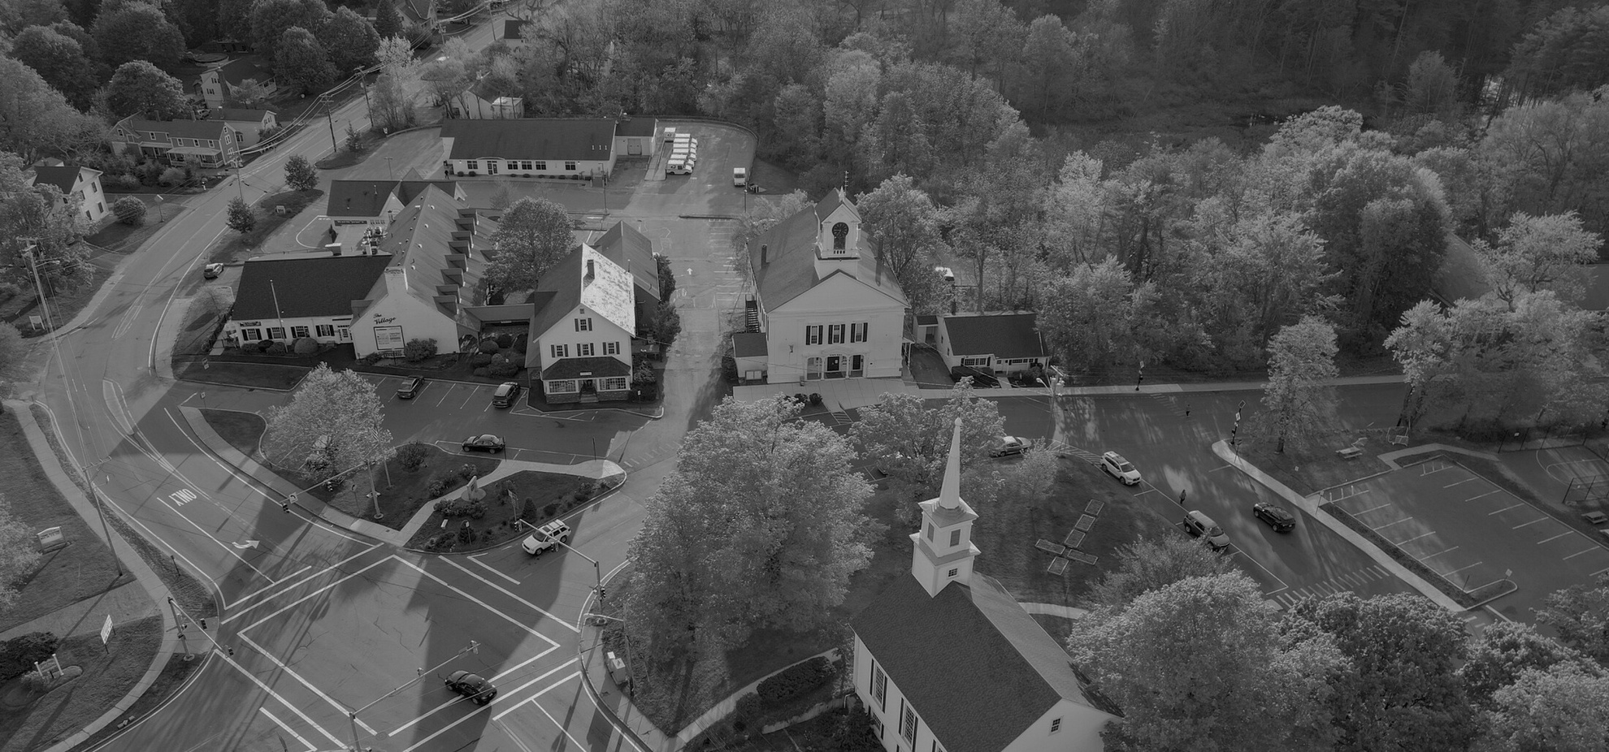
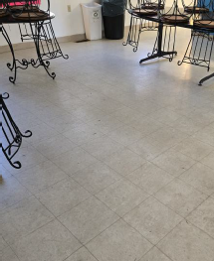
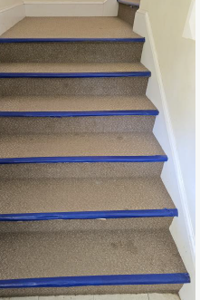
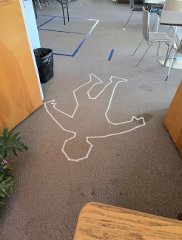
Preliminary
FY26 Capital Program
Teen Center, Replace Floors: $35,000
  This request is to replace all of the flooring at the teen center. Currently there is carpet on the second floor and staircase as well as VCT on the first level. It is the understanding of the facilities department that all of the flooring is original. All of the flooring is severely worn and the carpet has quite a bit of damage.

Slide 12
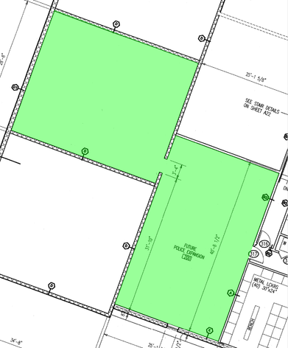
Preliminary
FY26 Capital Program
Public Safety Building 2nd Floor Design –
Office Space & File Storage: $42,000
  This request is for funding to complete design and engineering work to fit out the unused space on the 2nd floor of the Public Safety building. This space will be used for record storage as well as additional office space for the Police Department. This project is a high priority for the Department as they are currently out of space for their Officers and Detectives and have already converted their conference room into office space.

Slide 13
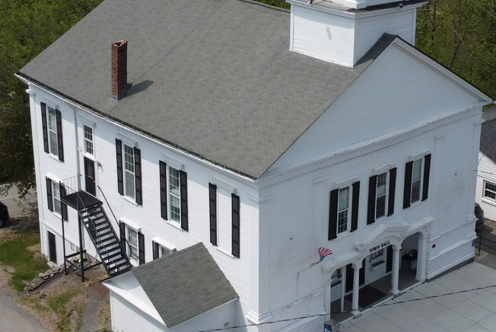
Preliminary
FY26 Capital Program
Town Hall, Window Replacement: $210,000
  The current Town Hall windows have been replaced before (with the exception of (5) original basement windows) with vinyl windows. These windows have gotten to a point where many of them are inoperable, some of the windows also extend above the ceiling level inside the space. The plan for the new windows is to have a fixed transom at the top and a regular double hung window below.

Slide 14
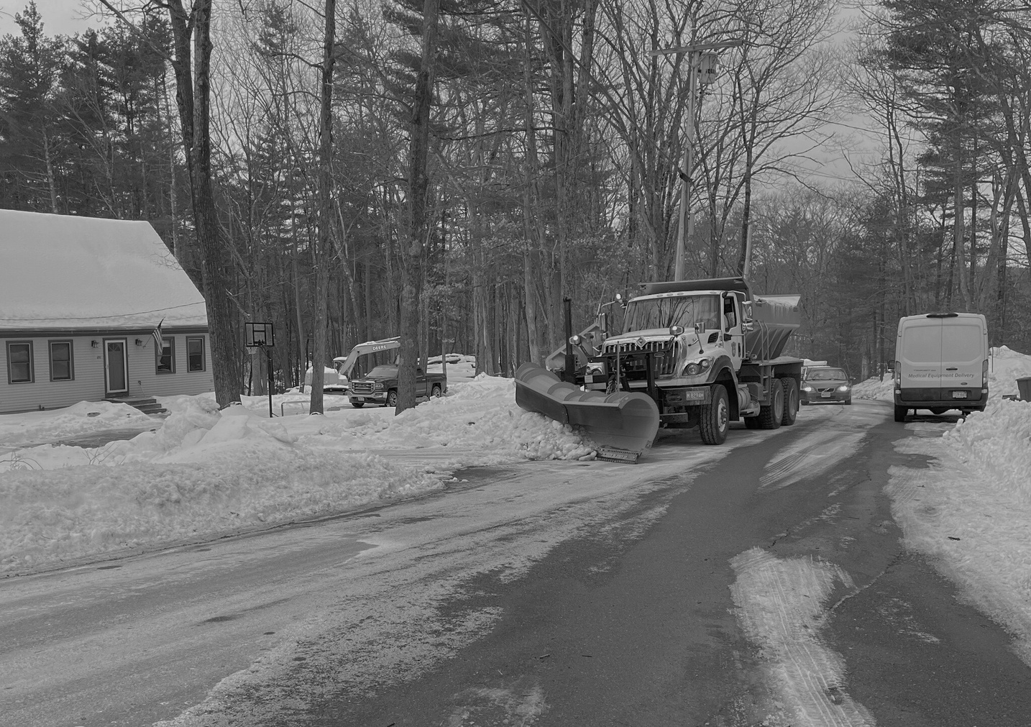
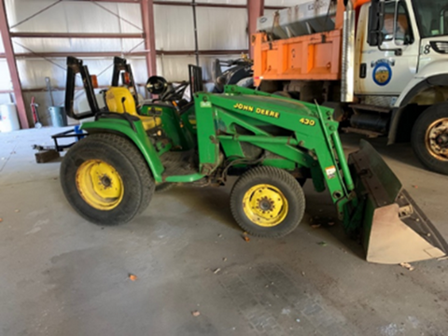

Preliminary
FY26 Capital Program
Compact Backhoe: $115,000
  This backhoe will replace the 24 year old John Deer Tractor which has a useful life of 15 years. The present tract only has a front bucket and the uses of the machine are limited. The compact backhoe will be used primarily in the Cemeteries to excavate graves and will be used for drainage repairs, roadway repairs, and snow and ice.

Slide 15
Preliminary
FY26 Capital Program
Replacement of Security Camera Central Server: $40,000
  Central server for the district security cameras is at the end of support (useful life of 10 years)

Slide 16
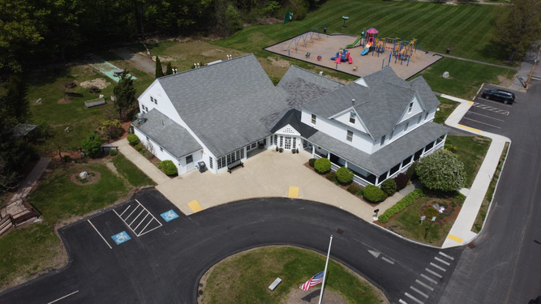
Preliminary
FY26 Capital Program
Senior Center Parking Design: $32,000
  This will fund an updated survey, conceptual and final drawings, drainage calculations, Site Plan Review with the Planning Board, bidding assistance, digging of test pits on site and construction estimation services.

Slide 17
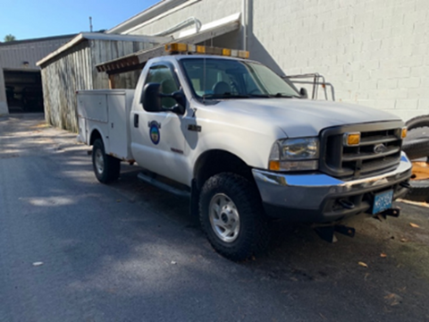
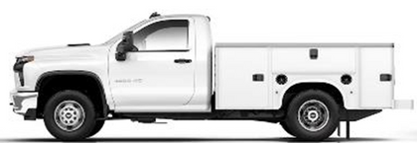
Preliminary
FY26 Capital Program
1 Ton Truck - Utility Body/Plow: $70,000
  This will replace a 20 year old truck that was taken out of service as repairs were not cost effective. This vehicle is used by the DPW Mechanic, for road repairs, and other work.

Slide 18
Preliminary
FY26 Capital Program
Primary School Window Safety Film: $26,865
  Solar reflective properties will reduce heat gain (will not darken the windows to the extent you cannot see from the outside)

Slide 19
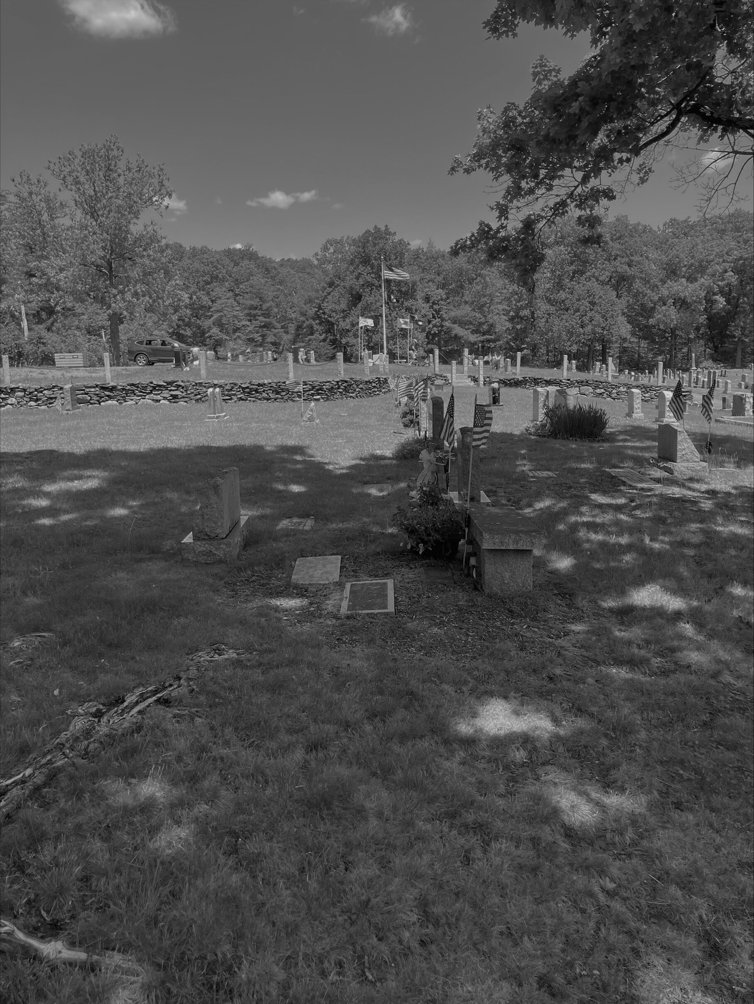
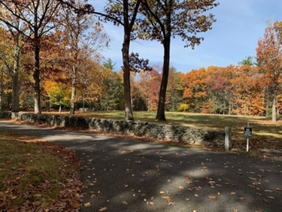
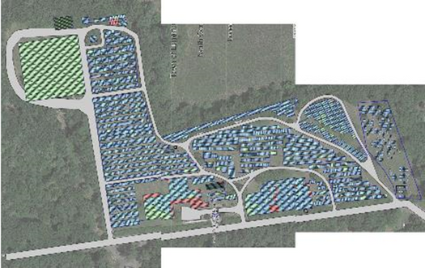
Preliminary
FY26 Capital Program
North Cemetery Expansion Area Prep: $50,000
Funds are required to advertise and award a contract to prepare the expansion area for new burial plots. There are less than 100 burial plots remaining at the North and South Cemeteries.

Slide 20
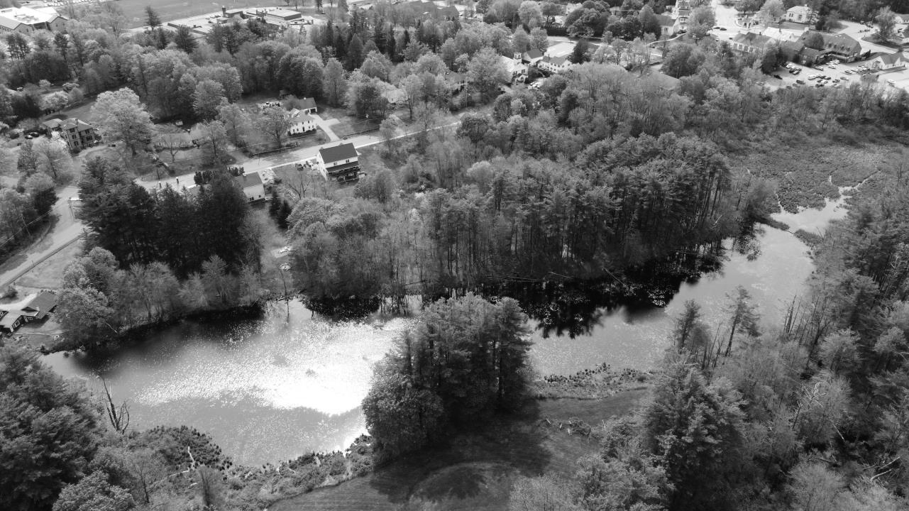
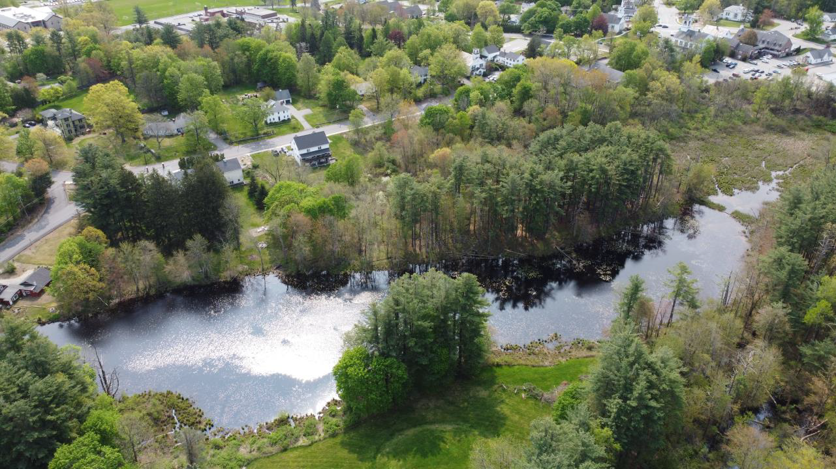
Preliminary
FY26 Capital Program
Marshall Pond Weed Treatment: $50,000
  The Parks Commission received an estimate of $256,000 to remove the weeds from the entire pond, but they are taking a more limited approach by doing some chemical treatment (EPA approved) and by using a hydro rake to dig the weeds out of the center of the pond only. This will allow the water to flow better through the pond and open it up to more recreational use.

Slide 21
Preliminary
FY26 Capital Program
Preliminary Funding Plan:
Free Cash Transfer- $615,588
FY2023 Capital Program Transfers- $325,000
Raise and Appropriate- $284,412

Slide 22
THANK YOU
Jennifer Warren-Dyment
Town Manager

