Slide 1
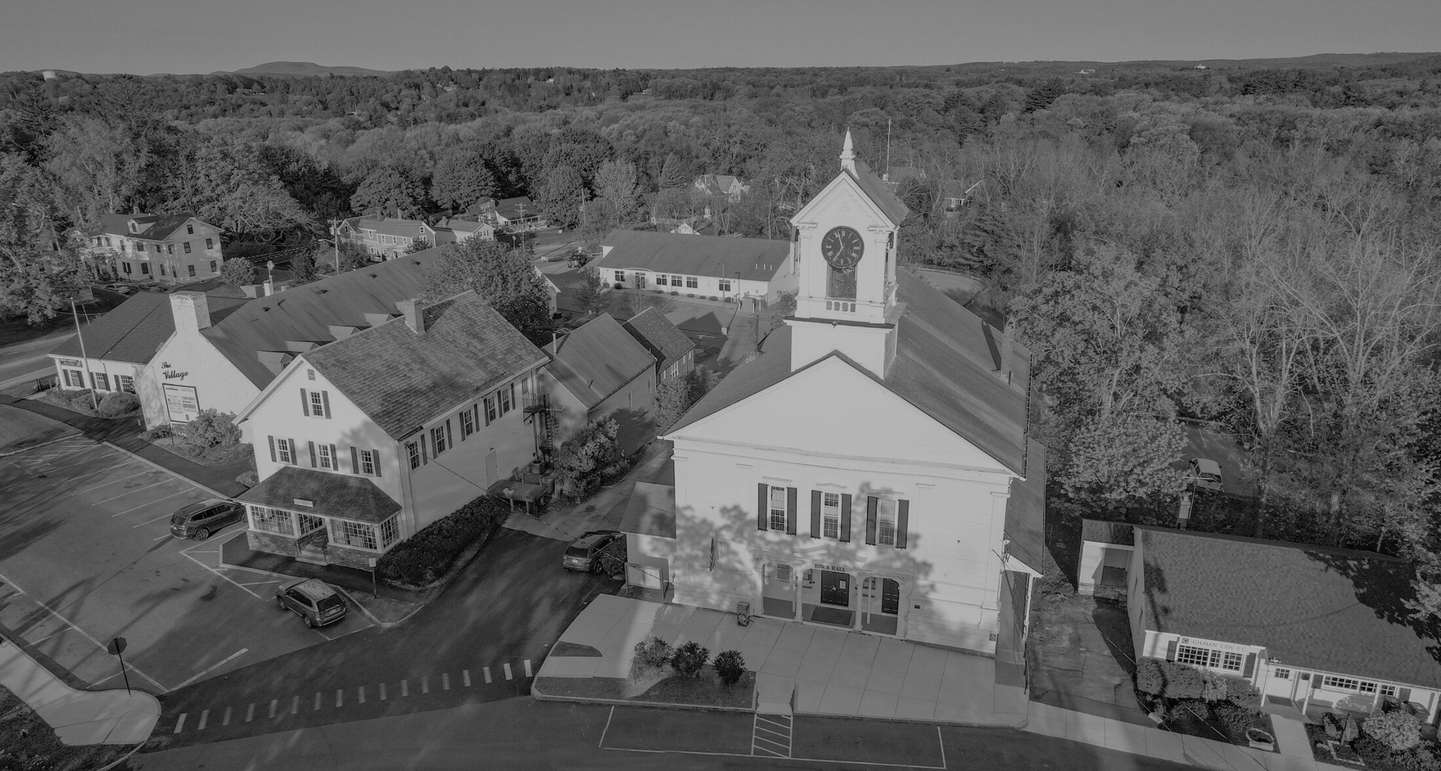

PRELIMINARY BUDGET PRESENTATION
TOWN OF LUNENBURG
FEBRUARY 19, 2026
Presented by
Jennifer Warren-Dyment
Town Manager

Slide 2
FY 2027 REVENUES

Slide 3
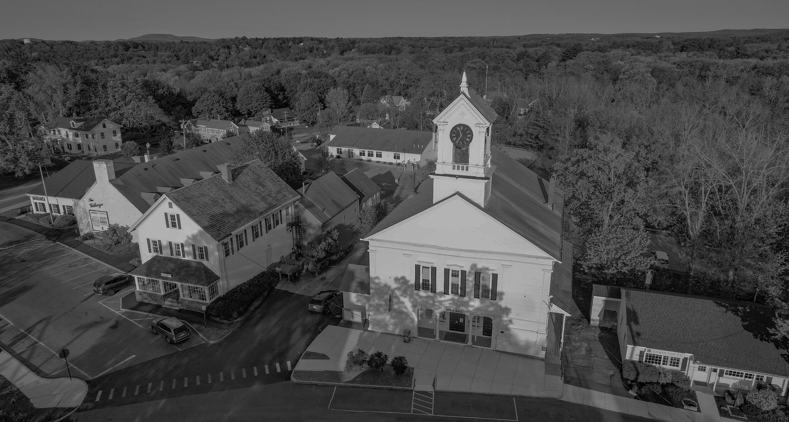
FY 2027 Revenues
Property Tax: $36,332,933.80
State Aid: $11,404,917.00
Local Receipts: $3,360,524.00
Enterprise Funds: $338,397.19*
Total: $51,436,771.99
*Under Review

Slide 4
FY 2027 Property Tax
Largest Piece of the Revenue Pie
FY 2026 Levy Limit: $32,910,811
2 ½% Increase: $822,770.28
Estimated New Growth: $400,000
Excluded Debt: $2,199,352.52
MAXIMUM ALLOWABLE LEVY: $36,332,933.80

Slide 5
New Growth
What is New Growth?
The additional tax revenue generated by new construction, renovations and other increases in the property tax base during a calendar year.
It does not include value increases caused by normal market forces or by revaluations.

Slide 6
New Growth
Some of FY25 growth attributable to Leominster-Shirley Rd. complex
*FY24 and *FY25 higher actual new growth due to new construction
and parcels missed in FY22 and FY23
FY27 New Growth Estimate: $400,000

Slide 7
Assuming Level State Aid
Second Largest Piece of the Revenue Pie
State Aid Receipts: $11,404,917
Education: $9,726,003
  Chapter 70: $9,349,335
  Charter Tuition Reimb.: $58,244
  Smart Growth Reimb.: $318,424
UGGA: $1,349,272
Veterans Benefits: $66,218
Exemptions: $102,040
State Owned Land: $49,237
Offset Receipts: $112,147
  School Choice Receiving Tuition: $77,329 (sweeps to school)
  Public Libraries: $34,818 (sweeps to library)
Cherry Sheet Assessments: $1,069,349
Mosquito Control: $91,562
Air Pollution Districts: $3,763
RMV Non-Renewal Surcharge: $8,060
MBTA: $24,713
Regional Transit: $66,681
School Choice Sending Tuition: $472,312
Charter School Sending Tuition: $402,258

Slide 8
FY 2027 Local Receipts Estimate
Smallest Piece of the Revenue Pie
Definition: Local estimated receipts include motor vehicle, meals and room excises, fines and forfeits, fees, licenses and permits, other departmental receipts, penalties and interest on taxes and excises and investment income.
They are separate from real and personal property tax levy receipts and vary greatly in amount among communities.
“Local receipts should be budgeted conservatively and not at historically high levels” - MA Division of Local Services

Slide 9
FY 2027 Local Receipts Estimate
Receipt Type | FY 25 Actual | FY 26 Budget | FY 27 Budget
Motor Vehicle Excise | $2,190,195.56 | $1,875,000 | $1,875,000
Meal & Cannabis Excise | $160,458.23 | $125,000* | $125,000
Penalties/Interest on Taxes and Excises | $141,872.02 | $140,000 | $140,000
PILOT | $1,605.75 | $1,600 | $1,600
Fees | $202,017.87 | $180,000 | $180,000
Dept. Revenue- Schools (Pre-School Tuition, Parking, Special Education Reimbursement) | $183,945.08 | $61,411 | $61,411
Dept. Revenue Cemetery Burials | $3,800.00 | $3,500 | $3,500
Other Departmental Revenue (Ambulance) | $481,173.92 | $275,000* | $275,000
Licenses/Permits | $353,444.01 | $350,000* | $350,000
Special Assessments (Trailer Parks) | $26,592.00 | $12,000 | $12,000
Fines and Forfeits | $17,432.57 | $12,013 | $12,013
Investment Income | $588,996.51 | $100,000* | $100,000
Misc. Non-Recurring (Sale of Property, Net Metering Credits, Meadow Woods P&I) | $280,843.25 | $225,000* | $225,000
* Increased in FY26. No adjustments in FY27.

Slide 10
FY 2027 Total Revenue Available
for Appropriation
Starting Revenue: $51,436,771.99
Less Non-Appropriated Expenses: $1,441,496
  Offset Receipts: $112,147 (School Choice and Library sweeps from the Cherry Sheet)
  Assessors Overlay: $260,000
  Cherry Sheet Assessments: $1,069,349
Less Levy Appropriated to the Capital Plan: $244,576
Total Revenues Available for Appropriation: $49,750,699.99

Slide 11
FY 2027 PRELIMINARY
EXPENDITURES

Slide 12
FY 2027 Expenditure Summary
Category | FY25 Budget | FY25 Actual | FY26 Budget | FY27 Preliminary | $ Change | % Change
Maturing Debt | $2,941,321.50 | $2,941,321.50 | $2,547,440.36 | $2,537,578.36 | ($9,862.00) | -0.39%
General Government Unclassified | $3,879,254.21 | $3,489,708.96 | $4,107,709.13 | $4,312,004.12 | $204,294.99 | 4.97%
General Government | $2,752,295.15 | $2,234,013.96 | $2,962,263.14 | $3,205,051.24 | $242,788.10 | 8.20%
Public Safety | $4,481,172.66 | $4,222,405.73 | $4,547,849.28 | $5,118,965.26 | $571,115.98 | 12.56%
DPW | $2,703,652.09 | $2,884,846.15 | $2,476,953.29 | $2,807,177.51 | $330,224.22 | 13.33%
Facilities and Buildings | $992,711.12 | $1,024,973.60 | $1,067,396.40 | $1,203,408.16 | $136,011.76 | 12.74%
Human Services | $456,731.74 | $411,404.60 | $478,242.76 | $480,162.04 | $1,919.28 | 0.40%
Schools | $26,109,022.00 | $25,611,971.71 | $27,121,995.00 | $30,115,565.00 | $2,993,570.00 | 11.04%
Culture and Recreation | $591,989.77 | $608,551.50 | $639,036.76 | $662,162.24 | $23,125.48 | 3.62%
Intergovernmental | $2,132,169.76 | $2,132,169.76 | $2,397,049.98 | $2,635,339.93 | $238,289.95 | 9.94%
Tax Title | $29,000.00 | $7,144.13 | $30,500.00 | $30,500.00 | $0.00 | 0.00%
Total | $47,069,320.00 | $45,568,511.89 | $48,376,436.10 | $53,107,913.86 | $4,731,477.76 | 9.78%

Slide 13
FY 2027 Expenditure Summary

Slide 14
Maturing Debt
$2,537,578.36
$9,862.00 / -.39% Decrease
Debt service is decreasing as borrowing is paid down.
Excluded Tax Supported Debt:
MS/HS Construction ($9M issue): $477,775.00
MS/HS Construction ($20.605M issue): $1,107,971.26
MS/HS Construction ($4.020M issue): $216,462.50
Pavement Management Plan (800k issue): $74,150.00
Pavement Management Plan (875k issue): $71,100.00
Pavement Management Plan ($1,150,000 issue): $115,800.00
Pavement Management Plan ($1,020,000 issue): $80,650.00
MS/HS Construction ($675,000 issue): $55,443.76

Slide 15
Maturing Debt
$2,537,578.36
$9,862.00 /.39% Decrease
Debt service is decreasing as borrowing is paid down.
Non Excluded Tax Supported Debt:
Comp Wastewater Mgmt. Plan 3/18/09 - (Series 14 Final): $20,325.76
Turf Field 1/25/17 ($760k): $76,450.00
Meadow Woods Water Project: $58,837.50
Enterprise Fund Supported Debt:
SRF Pool 13 (CW-00-39-D): $14,145.76
SRF Series 19 (CW-14-29): $73,791.82
Meadow Woods Sewer Project: $82,875.00
Sewer Bonds 1/25/17 ($145k): $11,800.00

Slide 16
General Government Unclassified
$4,312,004.12
$204,294.99 / 4.97% Increase
Budget Includes:
Workers Compensation: reduced by $10,000 (6.9% decrease)- based on actuals
Unemployment Compensation
Employee/Retiree Insurance (does not include school active employees):
    Active plan increase of 8.85%
    Retiree plan increases in January (estimating 16% increase on MBFS and 19% on Medex)
    Active negotiations with PEC- may affect final rates and opt out program
    Budgeting 6 Family and 6 Individual Blue Care Elect Plans
    Total Increase of $193,440.27 (5.86%)
Liability Insurance: $5,854.72 (2.5%) increase
Life Insurance: presently budgeted with $5,000 (33.33%) increase
Medicare: this is the FICA Medicare tax and is based on total payroll

Slide 17
General Government
$3,205,051.24
$242,788.10 / 8.20% Increase
Budget Includes:
Select Board: Fully funds PR/Crisis communication contract within Select Board budget, 21,615.01 (11.99%)
Town Manager: Funds ½ year of new Assistant Town Manager position at $60,000, assumes $15,000 increase to legal fees, reductions made to meetings, dues, and mileage- $77,028.00 (25.23%)
Finance Committee: Reduced meetings and schools by $225 (16.67% decrease)
Finance Committee Reserve
Salary Reserve: Has not been adjusted for FY27- will include COLA for SAP employees and any wage adjustments associated with three labor contracts under negotiation (DPW, Fire, and Clerical Union)

Slide 18
General Government
$3,205,051.24
$242,788.10 / 8.20% Increase
Budget Includes:
Town Accountant: Contractual increase for Finance Director/Town Accountant, $25,000 increase for annual audit, some reductions due to retirement $33,260.48 (10.29%)
Assessors: Includes $27,500 in funding for the temporary Special Assistant to the Assessor position to be utilized to achieve compliance with Department of Revenue directives- $27,632.46 (9.29%) total increase
Treasurer/Collector: Small adjustments for increased trainings for staff certification stipend for Collector- $7,814.36 (3.13%); $1,600 is above level services
IT: MUNIS no longer supported by ARPA, reduced IT contractor to 4 days per week, eliminated ClearGov software, telephone charges increased to actuals- $43,027.91 (8.76%) increase

Slide 19
General Government
$3,205,051.24
$242,788.10 / 8.20% Increase
Budget Includes:
Town Clerk/Elections/Registration & Census: Increases driven by election in FY27- $15,328.97 (8.73%)
Land Use: $5,805.91 (1.32%) increase
APDC
Town Report: Funds Town Report and Town Meeting mailers. Increased to actual costs- $9,000.00 (128.57%) increase
Central Purchasing: Level funded; includes postage for all Departments, beginning FY26
Physicals: Increase to actual costs- $2,500.00 (71.43%) increase

Slide 20
Public Safety
$5,118,965.26
$571,115.98 / 12.56% Increase
Budget Includes:
Police Department: Funds contractual obligations, eliminates one Sergeant position and 1 SRO, and adds one Detective- $175,385.45 (7.29%)
Police Lock Up
Injury Leave
Police/Fire Medical: Adjusted to actual costs- $2,000.00 (50%) increase
Fire Department: Funds the above-level service “Fourth Shift/42 Hour Schedule”. Includes wage adjustment for anticipated vacancy in Chief position due to retirement and increases to EMS Supply line- total Increase of $379,967.51 (22.12%)
Fire Hydrant Expense

Slide 21
Public Safety
$5,118,965.26
$571,115.98 / 12.56% Increase
Budget Includes:
Radio Equipment Maintenance 5,000 (50%) increase
Radio Watch: Assessment remained level due to addition of new member communities in the Regional Dispatch- increase of $2,000.02 (.97%)
Emergency Management
Sealer of Weights and Measures: Town contracts with Commonwealth- actual cost of contract requires budget increase of $6,763.00 (147.02%)
Animal Control

Slide 22
Public Works
$2,807,177.51
$330,224.22 / 13.33% Increase
Budget Includes:
Highway Administration: Does not include wage adjustments that are subject to collective bargaining. Contract expired June 30, 2024 and is currently under negotiations; includes new part-time administrative position at $25,000. $54,553.60 (8.47% increase)
Highway Construction and Maintenance: $25,000 increase to address backlog of drainage work, increase for streetlight costs, and $340,000 increase to address mandatory catch basin cleaning and sweeping. Pavement management plan not increased to pre-FY26 levels. Total increase of $371,000 (58.44%)
Traffic Signs & Devices: Reduced by $11,700 (41.05%)- Reduced line striping

Slide 23
Public Works
$2,807,177.51
$330,224.22 / 13.33% Increase
Budget Includes:
Vehicle Maintenance DPW: $5,000 (7.97% increase)
Vehicle Maintenance Police
Vehicle Maintenance Fire: $10,000 (20% increase)
Cemetery- Contract under negotiation
Tree Removal: $1,000 (2.6%) increase to overtime line
Snow Removal: Allowed to deficit spend. $8,889.29 (2.5%) increase
Recycling Program: $106,646 (22.69%) decrease after review of past year expenditures

Slide 24
Facilities and Buildings
$1,203,408.16
$136,011.76 / 12.74% Increase
Budget Includes:
Facilities and Grounds: Contract under negotiation. Includes additional $25,000 increase to purchase of services line ($15,000 of which is above level services) as well as $7,500 vehicle allowance for Director. Total increase of $58,868.86 (8.27%)
Public Buildings: Increases to electricity, trash, gas, water, and sewer. Increases include costs associated with budgeting the operations of the TC Passios building- $66,142.90 (29.88%) increase
Park Department: Recreation Director position is vacant, but Town is actively interviewing. $1,000 increase to beach salaries and $10,000 increase for landscaping- total increase of $11,000 (8.18%)

Slide 25
Human Services
$480,162.04
$1,919.28 / .040% Increase
Budget Includes:
General Health Expense: $1,123.56 (1.98%) increase
Nashoba Board of Health: $14,344.60 (30%) assessment increase
Nashoba Nursing: $6,574.62 (30%) assessment increase
Council on Aging: Discussing staffing configurations with Director; currently at a $20,147.50 decrease, but may change based on discussions
Veteran’s Administration

Slide 26
Schools
$30,115,565.00
$2,993,570.00 / 11.04% Increase
Budget Includes:
Lunenburg Public Schools: $2,875,712.00 (11.15%) increase
Monty Tech: $117,858.00 (8.83%) increase

Slide 27
Culture and Recreation
$662,162.24
$23,125.48 / 3.62% Increase
Budget Includes:
Band Concerts
Library: $5,000 above level service increase to programs, with offsetting decrease to book service, $10,937 increase to library materials, and increase to professional development, with offsetting decrease to mileage- total increase of $23,125.48 (3.66%)
Historical Commission

Slide 28
Intergovernmental
$2,635,339.93
$238,289.95 / 9.94% Increase
Budget Includes:
Worcester Regional Retirement: $238,178 (9.95% increase)
Montachusett Regional Planning Commission: $111.95 (2.5% increase)
Note: In FY26 Cherry Sheet Assessments were moved inside of the operating budget. That will revert in FY27.

Slide 29
Tax Title
$30,500.00
No changes to tax title budget.

Slide 30
Ongoing Matters with
Budgetary Impact
The Town is currently negotiating with 3 labor unions: DPW (out of a contract since June 30, 2024) Fire, and the Clerical Union.
Negotiations ongoing with the Public Employee Committee relative to health insurance.
Potential wind-down of the operations of the TC Passios building and subsequent impact to PACC operating budget.
Exploring changes to the recycling program.
Exploring feasibility of further service reduction with IT service provider.
Staffing configuration at Adult Activity Center.
Parks staffing configuration if PT Recreation Director is not filled.
Salary Administrative Plan employees COLA.

Slide 31
FY27 Budget as Presented
v.
Available Funds
The Total FY27 Town of Lunenburg Budget as Presented: $53,107,913.87
Total available revenues for FY27: $49,750,699.99
TOTAL FY27 DEFICIT: $3,357,213.88

Slide 32
FY27 Budget as Presented
v.
Available Funds
The total “new revenue” for FY27 is $1,374,263.89
The FY27 Monty Tech assessment is $117,858.00
This leaves $1,256,405.89

Slide 33
FY27 Budget as Presented
v.
Available Funds
Presently the School is 53.33% of the budget and the Town is 43.91%.
If the $1,256,405.89 is distributed proportionally:
School: $689,059.28
FY27 School Budget Increase: $2,875,712.00
Deficit: $2,186,652.72
Town: $567,346.61
FY27 Town Budget Increase: $1,737,907.77
Deficit: $1,170,561.16

Slide 34
What’s Next?
Once Free Cash is Certified, we will revisit FY27 Capital Plan and other planned expenditures (OPEB, Stabilization, Snow & Ice, etc.)
Departmental Presentations to Finance Committee continue.
Budgets are revised over the next weeks and months.
Tri-Board reconvenes to discuss next steps.

Slide 35
What’s Next?
Fourth Shift Fire Presentation 2.23.26
Finance Committee Public Hearing 3.19.26
FY27 Budget Forums to be scheduled
Annual Town Meeting 5.2.26 at 9:00 a.m.
State Budget finalized by early summer

Slide 36
THANK YOU

